Slide 1
While loops
Sentinel logic, flags, break
Taken from notes by Dr. Neil Moore

Slide 2
While loops
If you read the instructions on most shampoo bottles, “Lather, rinse, repeat” is what they say.
This has a problem that it will never stop!
How would you fix it?
  Later
  Rinse
  Repeat if necessary

Slide 3
Bounded and unbounded iteration
The for loops we’ve been using are bounded or definite loops.
The interpreter knows in advance how many times the loop will run
That does not change once the loop starts.
  For i in range(5):
  i = 1
  print(i)
  Even though we are changing I, the loop still runs five times!
That’s kind of nice because it prevents infinite loops!

Slide 4
Unbounded iteration
An example: asking the user to input a positive number
  If they give a negative number or zero, we’ll repeat the question.
  How many times do we need to repeat it?
  No way to know in advance

Slide 5
Unbounded iteration
So we need some way to make a loop that can run an unlimited number of times
  An unbounded or indefinite loop
  Indefinite, not infinite!
    Most loops should stop eventually – we just can’t say when
    “Repeat if necessary” – we just need to describe “necessary”

Slide 6
While loop syntax and semantics
Syntax:
while condition:
body
    The condition is a boolean expression, just like an if.
    The body is an indented block of code
Semantics
  Check the loop condition
  If False, end the loop
  If True, run the body and repeat steps 1-3
  If the condition is False to begin with, the body never runs!

Slide 7
While loop syntax and semantics
Structured programming guarantees
  One entrance: always starts by checking the condition at the top
  One exit: ends only when the condition is False
  Only checks the condition again after running the entire body
    Does NOT jump out of the body statements

Slide 8
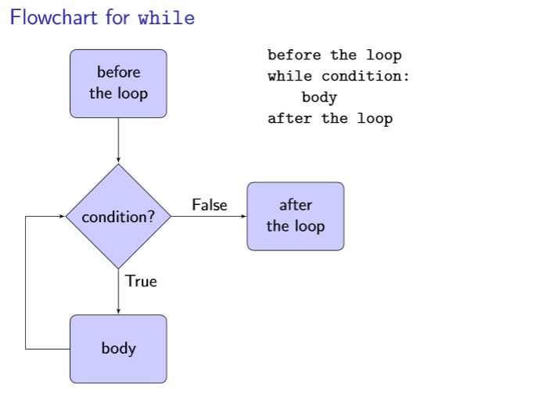
Flowchart for while

Slide 9
Common errors with loops
What happens if the condition is a tautology (always True)?
  The loop never ends!
  An infinite loop is usually an error
    Unless you are writing an Operating System
Conversely, what if the condition is a contradiction (always False)?
  The body will never run at all
  Which is called dead code!

Slide 10
Confusion between while and if statements
While loops and if statements DO look similar on the surface
  They both use boolean expressions on the first line of the structure
  They both have indented bodies
They are NOT the same!
  If you need to repeat code, use a while
  If you need to test something only ONE time, use an if
If you need to test something repeatedly, you need an if statement INSIDE a loop (for or while)

Slide 11
Sentinel Logic
One common use for a while loop is to process data.
We want to keep getting more data until we see a special value
  Read from a file until you see a blank line
  Ask for a number until the user enters zero.
  Get commands from the user until they type “quit”
  Read and log temperatures until one is out of range
  This special value (or values) is called a sentinel
    Just a fancy word for “guard”
Sounds like a job for a while loop!
  But a while loop checks the condition at the start
  Be we can’t check until we have the first input data!

Slide 12
Loops with sentinel logic
The solution: the sentinel loop pattern
You get the input in two places
  Just before the loop starts
  as the last step of the loop body
  Get the first input
  while the input is not a sentinel:
    2.1 Do something with the input
    2.2 Get the next input
    num = int(input(“Enter a number, 0 to exit: “))
    while num != 0:
    print(“Its reciprocal is”, 1 / num)
    num = int(input(“Enter a number, 0 to exit: “))

Slide 13
Input validation
Users input all kinds of values which are not valid for the program. The program should protect itself from this “bad data” by refusing it and asking for another value.
This logic is similar to sentinel value logic but as a slight twist:
  You repeat the loop if the input is bad
  So the “sentinel” is any good input
  What goes in the body of the loop?
    An error message to the user
    Get the next input
Example: positive.py

Slide 14
Loop example: numeric input
Remember our programs with int(input(…)). What happens when the user gives non-numeric input?
It crashed. Which part, exactly, crashed?
  The type cast!
  So can we validate the input before doing the typecast?

Slide 15
Loop example: numeric input
Python gives us a way to check if a string contains only digits.
  mystr.isdigit()
    remember the dot? a string is an object, isdigit is a method
  isdigit returns True if
    The string contains no non-digit characters, and
    It has at least one digit (so the method is badly named)
  It only works for non-negative integers, because “.” and “-” are not digits!
    There are other special symbols too, Arabic digits, etc.
    Later we will see how to do this properly with exceptions
numeric.py

Slide 16
Flags and while loops
Sometimes we only discover inside the loop that we want to leave the loop
For example, “do you want to play again?”
The best way to control this is to use a flag.
  A Boolean variable, we saw these with the if
  Use the flag as the condition of the while
  Initialize the flag before the loop
  When we discover that we’re done, change the flag’s value

Slide 17
While loop with a flag
done = False
while not done:
play a round
done = not play_again()
#assume play_again returns True/False
Why don’t we use sentinel logic?
Sentinel logic would ask before the loop starts
but we want to play a round before we ask!

Slide 18
While loops with a counter
While loops can be combined with a counter to simulate a for loop over a range
Initialize the counter to the starting value
While the counter is less than the stop value:
  Do stuff
  Add the step value to the counter variable

Slide 19
While loops with a counter
  i = 0
  while i < 4:
  print(i, “squared is”, i**2)
  i += 1
  Why would you ever write it this way?
    Maybe the step size changes
    Maybe there are multiple stopping conditions, not just the counter reaching the stop value

Slide 20
Another loop example: any
Remember our “any” flag pattern:
anyodd = False
for num in 2, 1, 4, 16, 12, 0, 3:
if num % 2 == 1:
anyodd = True
What if we don’t have all the numbers in advance?
  Then we can’t use a list with the for loop
Also notice that it keeps going even after we’re sure the answer is True
  Because anyodd can never become False again
As soon as we see an odd number, we can stop because the answer must be True!
We can solve both problems with a while loop and a flag!

Slide 21
While loop example: any
Let’s solve the first problem and make it accept any number of inputs. We need a sentinel value: let’s use 0.
anyodd = False
num = int(input(“Enter an int, 0 to quit. “))
while num != 0:
if num % 2 == 1:
anyodd = True
num = int(input(“Enter an int, 0 to quit. “))
If anyodd:
print(“At least one number was odd.”)
else:
print(“no odd numbers found.”)

Slide 22
While loop with multiple exits
It still asks for more numbers after an odd one was seen. Let’s fix that.
Stop the loop if anyodd is True.
  It can never become False again.
But we still want to stop the loop if the input is zero
  Stop the loop if anyodd is True or the input is 0.
  Continue the loop if anyodd is False and the input is not zero.
    deMorgan’s Law: “not (A or B)” = “(not A) and (not B)”

Slide 23
While loop example: any
anyodd = False
num = int(input(“Enter an int, 0 to quit. “))
while not anyodd and num != 0:
if num % 2 == 1:
anyodd = True
else: # don’t ask if we’re going to quit
num = int(input(“Enter an int, 0 to quit”))
if anyodd:
print(“At least one odd number seen.”)
else:
print(“no odd numbers found.”) anyodd-2.py

Slide 24
Common errors with flags
Accidentally using or instead of and
  The loop will run too long
  If the condition is a tautology, it’s an infinite loop
Accidentally using and instead of or
  The loop won’t run long enough
  If the condition is a contradiction, doesn’t run at all
Not initializing the flag
  Causes a run-time error
Always setting the flag, every iteration
  Let’s see an example of that

Slide 25
Broken loop: unconditional flag
anyodd = False
num = int(input(“Enter an int, 0 to quit. “))
while num != 0:
if num % 2 == 1:
anyodd = True
else:
anyodd = False # BAD code!!
num = int(input(“Enter int, 0 to quit. “))
If anyodd:
print(“At least one number was odd.”)
else:
print(“no odd numbers found.”)

Slide 26
Broken loop: unconditional flag
This version sets the flag every time through the loop
So the flag won’t actually mean “are any numbers odd?”
Instead, this version only cares about the last number.
  Seeing an even number shouldn’t change our answer at all!

Slide 27
Break – don’t do it!
There is a keyword break which is a statement by itself. So syntax is simple, just break.
The semantics is simple too – it must appear inside a loop and it causes the loop to exit immediately
Example:
  for i in range(20): #it runs 20 times
  if i == 5:
  break
  print(i)
  What does this code actually print?

Slide 28
Break – don’t do it!
Objections to this:
  Breaks the guarantee of structured programming
    One entrance, one exit
      This loop looks like it has TWO exits!
  It’s harder to read this code and be sure when the loop actually stops!
    Any loop should be documented at the top as to how many times it repeats or what the exit conditions
      Remember the while loop with two conditions
  It’s a bad habit to get into!
  It is NOT allowed in this class at all – for any reason.

Slide 29
Sentinel logic: recap
Sentinel logic is repeating some code until you see a special value (or values)
Get input both before the loop and at the bottom of the body of the loop
“Enter a number or 0 to quit.”
  Keep asking until we see the sentinel 0
  While the number is not zero…
  Inside the loop, process the (nonzero) number

Slide 30
Sentinel logic: recap
In reverse: input validation
  Keep asking until we get what we want
  Now a good value makes us leave the loop
  While the number is not positive…
  Inside the loop, print an error message
  Process the valid input after the loop is over.

